Slide 1
Steam Turbine
bme207196@gmail.com

Slide 2
Steam Turbine
Steam turbines use the steam as a working fluid. In steam turbines, high pressure steam from the boiler is expanded in nozzle, in which the enthalpy of steam being converted into kinetic energy. Thus, the steam at high velocity at the exit of nozzle impinges over the moving blades (rotor) which cause to change the flow direction of steam and thus cause a tangential force on the rotor blades. Due to this dynamic action between the rotor and the steam, thus the work is developed.

Slide 3
Steam Turbine Fundamentals
Overview
Hero Reaction Turbine – 120 B.C.
First Practical Turbine – 1884, C. Parsons
First Power Plant – 7.5 kw – 1890
Reaction, Impulse and Velocity-Compounded
Reheat Steam – 1930’s
Last 100 years Turbine is the key element in generating electricity
Turbines run Generators, Pumps, Fans, etc.
Today up to 1,500 MW

Slide 4
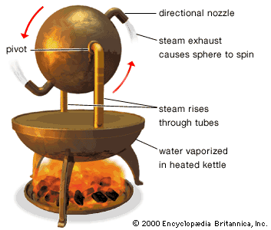
Overview

Slide 5
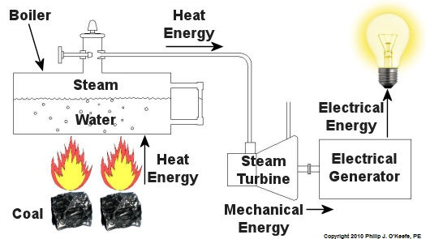
Fundamentals
Energy Transfer
Coal, Natural Gas, Nuclear, Biofuel, Waste Fuel

Slide 6
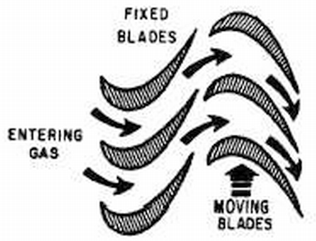
Reaction Turbines
Newton’s third law of motion – For every action there is an equal and opposite reaction.
Narrowing Steam Path
Narrowing Steam Path

Slide 7
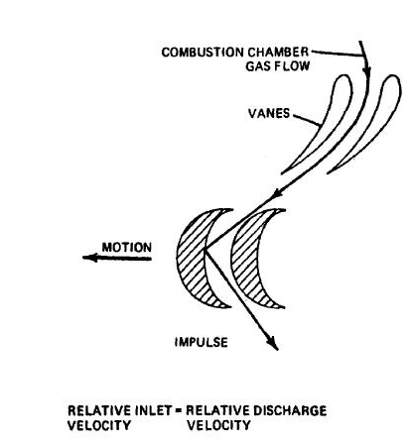
Impulse Turbines
Steam / Gas Flow
Fixed Vanes
Moving Blades

Slide 8
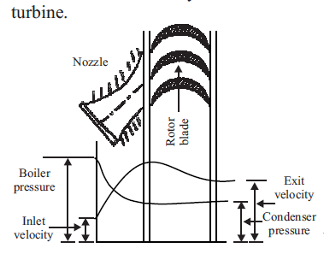
Type of turbine
Impulse turbine
the whole enthalpy drop (pressure drop) occurs in the nozzle itself. Hence pressure remain constant when the fluid pass over the rotor blades. Figure shows the schematic diagram of Impulse turbine

Slide 9
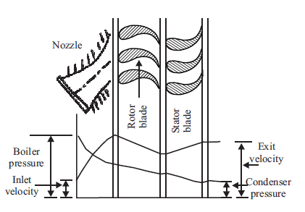
Type of turbine
Reaction turbines
in addition to the pressure drop in the nozzle there will also be pressure drop occur when the fluid passes over the rotor blades.

Slide 10
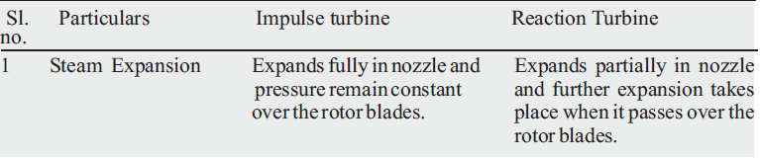
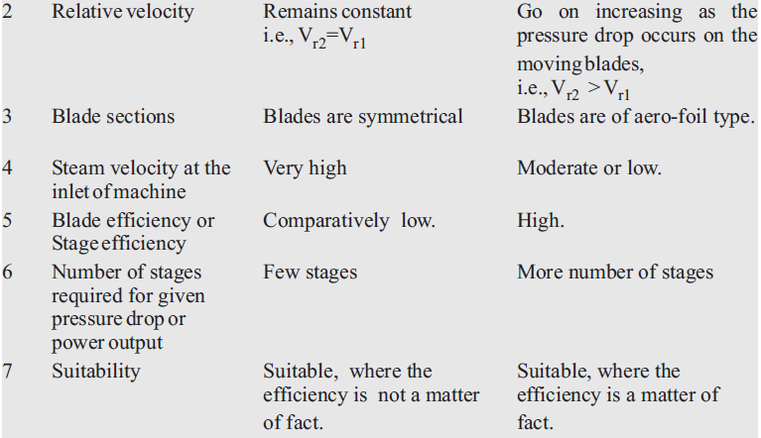
Difference between Impulse & Reaction Steam Turbine

Slide 11
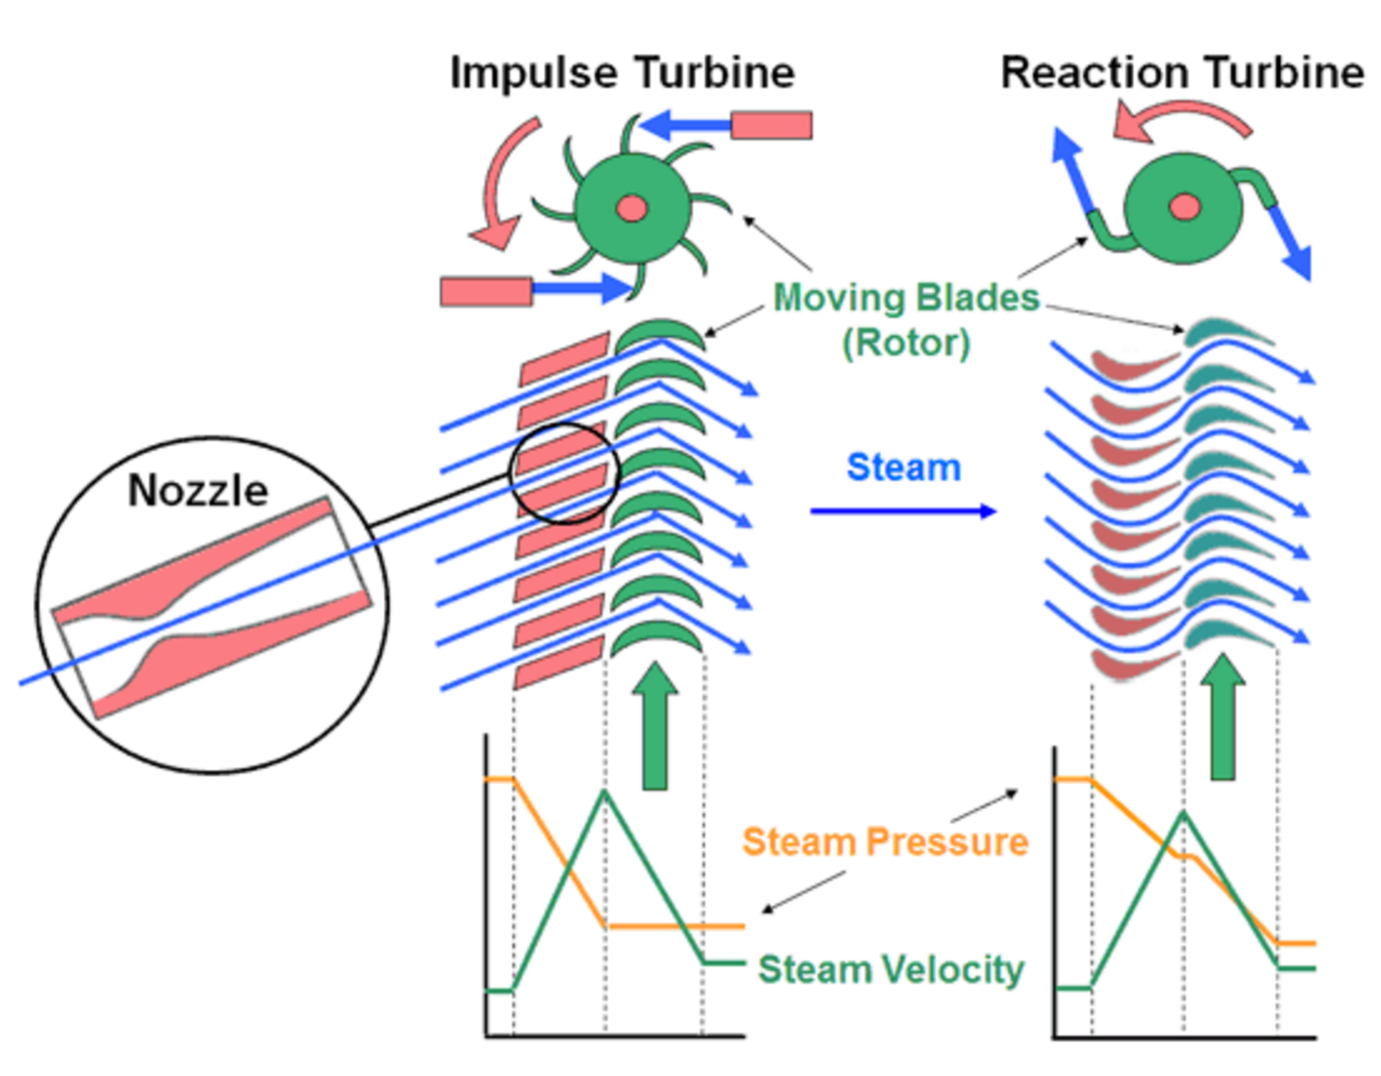
Reaction – Impulse Comparison

Slide 12
Nozzle
Key to achieving high efficiency in both impulse and reaction turbines is the design of the nozzles. They are normally a convergent-divergent (hourglass) shape which increases the velocity of the inlet steam while reducing its pressure. Increasing the velocity of the steam by means of a flared nozzle output orifice may seem counter-intuitive since water flows faster through a constricted part of a stream or a pipe and squeezing the end of a hosepipe causes the water to squirt out in a long, fast jet. This occurs because the water is an incompressible fluid. Steam on the other hand is a gas and its volume is not fixed but depends on its temperature and pressure. Gas dynamics are therefore quite different from hydrodynamics, however the conservation of energy principle still holds for both fluids and Bernoulli's Law indicates that kinetic energy of a gas increases as pressure energy falls.
This flared nozzle design was discovered by de Laval and applies equally to the nozzles of rocket engines whose working fluid is hot exhaust gas. See Rocket Nozzles for more about the principles involved.

Slide 13
Impulse turbine
The steam jets in an impulse turbine are directed by the fixed nozzles at the turbine's bucket shaped rotor blades where the force exerted by the jets causes the rotor to turn while at the same time the velocity of the steam is reduced as it imparts its kinetic energy to the blades. The blades in turn change change the direction of flow of the steam and this change of momentum corresponds to the increased momentum of the rotor. (Descartes - Conservation of momentum). The entire pressure drop in the turbine stage occurs in the fixed nozzles in the stator and there is no pressure drop as the steam passes through the rotor blades since the cross section of the chamber between the blades is constant. Impulse turbines are therefore also known as constant pressure turbines.
Steam impulse turbines usually operate at extremely high speeds of 30,000 r.p.m. or more and are thus subject to enormous centrifugal forces. For most practical applications the speed must be geared down. Other than that, the design is relatively simple and the turbine casing does not necessarily need to be pressure proof.
In a compound turbine, the next series of fixed blades reverses the direction of the steam before it passes to the second row of rotor blades.

Slide 14
Reaction Turbine
Both the fixed and the rotor blades of the reaction turbine are shaped more like aerofoils, arranged such that the cross section of the blades diminishes from the inlet side towards the exhaust side of the blades. This means that the cross section of the steam passages between both sets of fixed and rotor blades increases across the turbine stage. In this way both sets of blades essentially form nozzles so that as the steam progresses through both the stator and the rotor its pressure decreases causing its velocity to increase. The rotor becomes basically a set of rotating nozzles.
As the steam emerges in a jet from between each set of rotor blades, it creates a reactive force on the blades which in turn creates the turning moment on the turbine rotor, just as in Hero's steam engine. (Newton's Third Law - For every action there is an equal and opposite reaction)
Reaction turbines are generally much more efficient than impulse turbines and run at lower speeds which means they don't necessarily need reduction gearing. They are however more complex and the high pressure steam makes them more susceptible to leaks between the stages.

Slide 15
Compounding of Steam Turbines
method of obtaining reasonable tangential speed of rotor for a given overall pressure drop by using more than one stages.
Compounding is necessary for steam turbines because if the tangential blade tip velocity greater than 400 m/s, then the blade tips are subjected to centrifugal stress. Due this, utilization is low hence the efficiency of the stage is also low.

Slide 16
methods
1. Velocity Compounding (Curtis Stage) of Impulse Turbine :
This consists of set of nozzles, rows of moving blades (rotor) & a rows of stationary blades (stator) corresponding velocity compounding Impulse Turbine.
The function of stationary blades is to direct the steam coming from the first moving row to the next moving row without appreciable change in velocity. All the kinetic energy available at the nozzle exit is successively absorbed by all the moving rows & the steam is sent from the last moving row with low velocity to achieve high utilization. The turbine works under this type of compounding stage is called velocity compounded turbine.

Slide 17
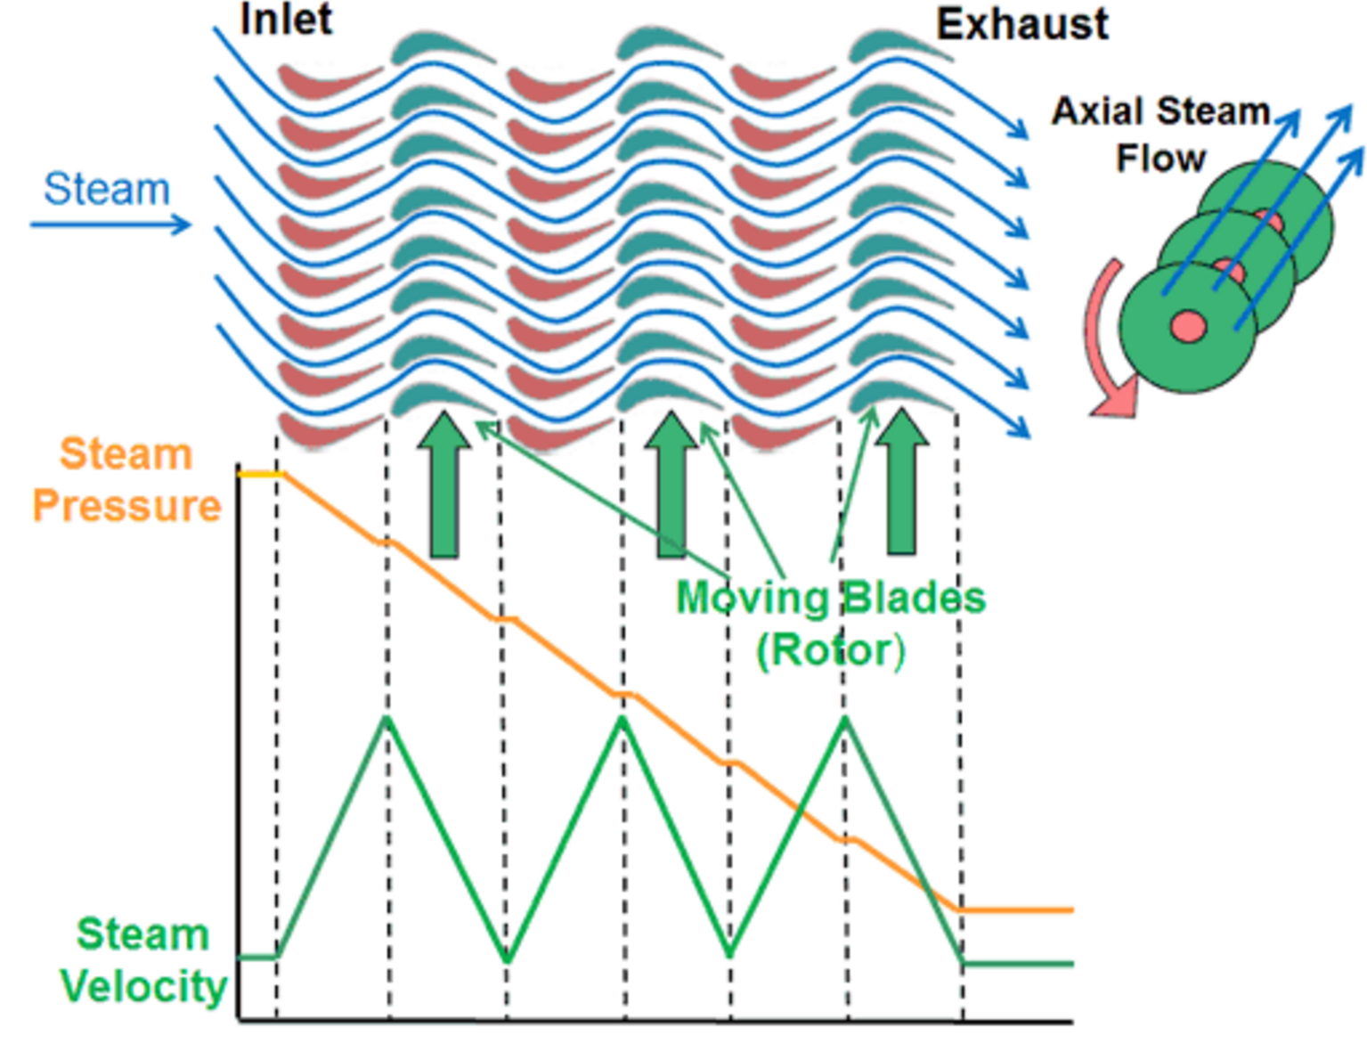

Slide 18
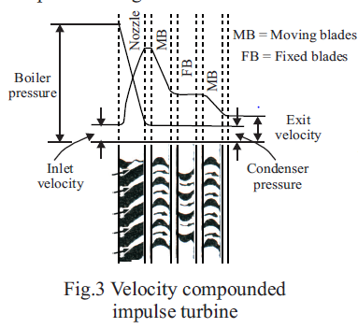

Slide 19
3.2 Pressure Compounded (Rateau Stage ) Impulse Turbine :
A number of simple impulse stages arranged in series is called as pressure compounding. In this case, the turbine is provided with rows of fixed blades which acts as a nozzles at the entry of each rows of moving blades. The total pressure drop of steam does not take place in a single nozzle but divided among all the rows of fixed blades which act as nozzle for the next moving rows..
Pressure compounding leads to higher efficiencies because very high flow velocities are avoided through the use of purely convergent nozzles. For maximum utilization, the absolute velocity of steam at the outlet of the last rotor must be axially directed. It is usually in large turbines to have pressure compounded or reaction stages after the velocity compounded stage.

Slide 20
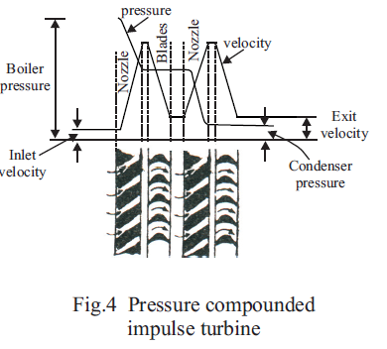

Slide 21
3. Pressure -Velocity Compounding
In this method, high rotor speeds are reduced without sacrificing the efficiency or the output. Pressure drop from the chest pressure to the condenser pressure occurs at two stages. This type of arrangement is very popular due to simple construction as compared to pressure compounding steam turbine.
set of nozzles and rows of moving blades fixed to the shaft and rows of fixed blades to casing. The entire expansion takes place in the nozzles. The high velocity steam parts with only portion of the kinetic energy in the first set of the moving blades and then passed on to fixed blades where only change in direction of jet takes place without appreciable loss in velocity. This jet then passes on to another set of moving vanes where further drop in kinetic energy occurs. This type of turbine is also called CurtisTurbine.

Slide 22
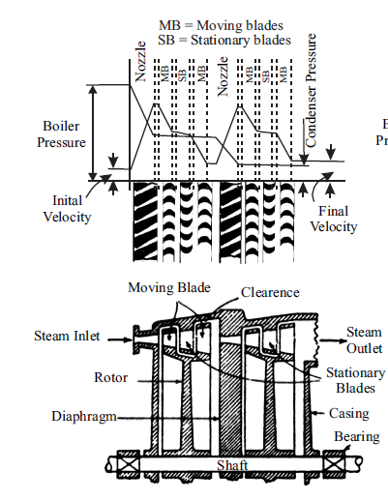

Slide 23
Analysis on Single Stage Impulse Turbine :

Slide 24
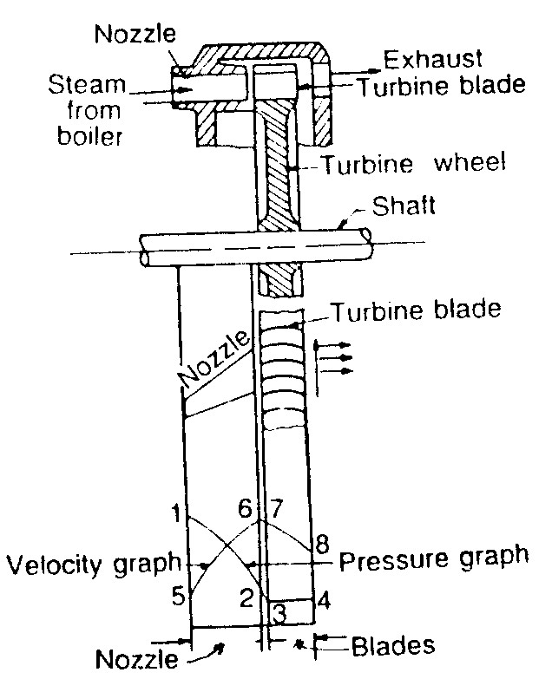
Pressure and velocity:
1234- pressure at entrance of nozzle, exit of nozzle, entrance of blades and exit of blades.
5678- velocity at entrance of nozzle, exit of nozzle, entrance of blades and exit of blades.
The pressure of steam jet reduced in the nozzle and remains constant while passing through moving blades.
Velocity of S is increased in nozzle and reduced while passing through moving blades.

Slide 25
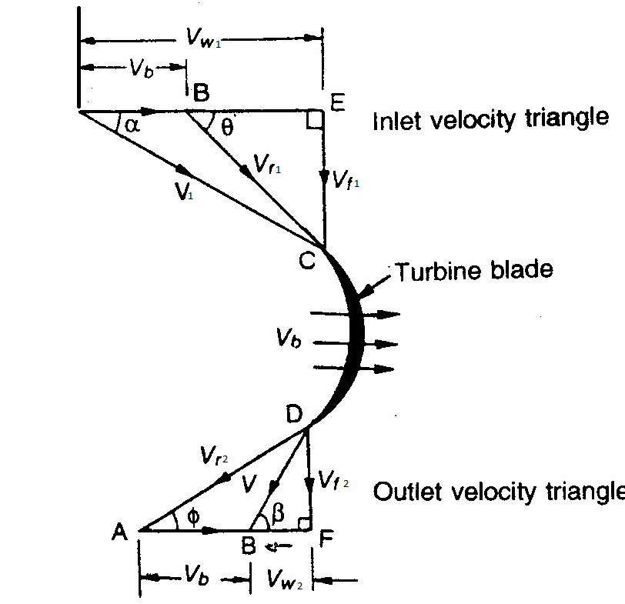
Velocity triangle:
Analysis on Single Stage Impulse Turbine :
Steam jet after leaving nozzle impinges on one end of blade.
Glides over the inside surface of the blade and finally leaves from the other edge.
Jet enters and leave the blades tangentially and shock less.
Note: V_{r}=V_{r1}

Slide 26
Symbols used for velocity vector as follows :

Slide 27
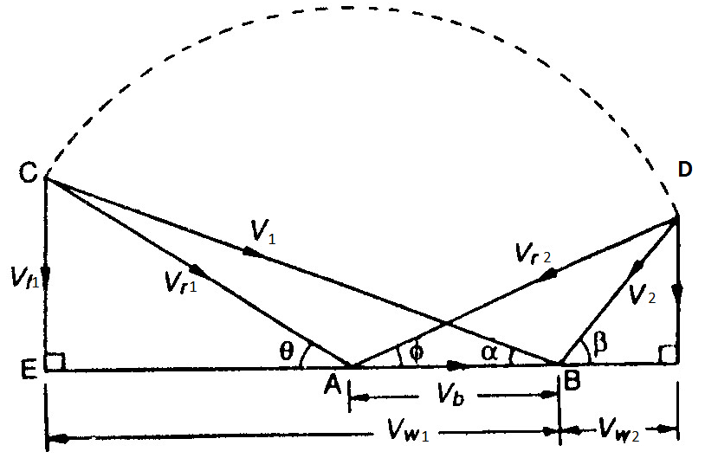
Combine Velocity triangle:
For the sake of simplification and solving problems.
AB=Vb
BC=V1,α
AC=Vr1
AD= Vr2, φ
AC=AD
Vr2=Vr2
BD=V2
D

Slide 28
Power produced:
Mass of Steam flowing through Turbine =m kg/s
Change in velocity of whirl= (V_{w1}+V_{w2})
Force in the direction of motion, F_{x}= m(V_{w1}+V_{w2})
Work done in the direction of motion, W_{x}= m(V_{w1}+V_{w2})u
Power produced by Turbine, P= m(V_{w1}+V_{w2})u
Axial thrust on the wheel, Fy=m(V_{f1}+V_{f2})
Where u- blade velocity

Slide 29
Problems 1
Example 1 :
A single stage Impulse turbine has a diameter of 1.5 m. and running at 3000 rpm. The nozzle angle is 20 . Speed ratio is 0.45. Ratio of relative velocity at the outlet to that at inlet is 0.9. The outlet angle of the blade is 3 less than inlet angle. Steam flow rate is 6 kg/s. Draw the velocity diagrams and find the following.
Velocity of whirl
Axial thrust
Blade angles
Power developed.

Slide 30
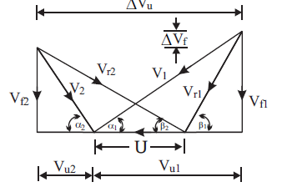

Slide 31
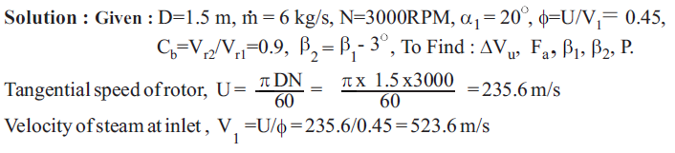
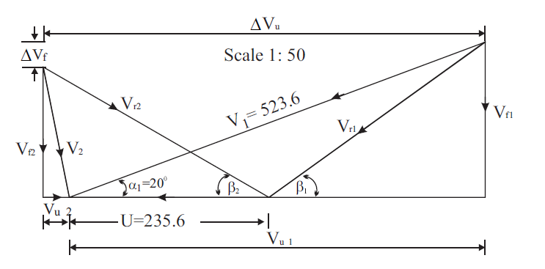
solution

Slide 32
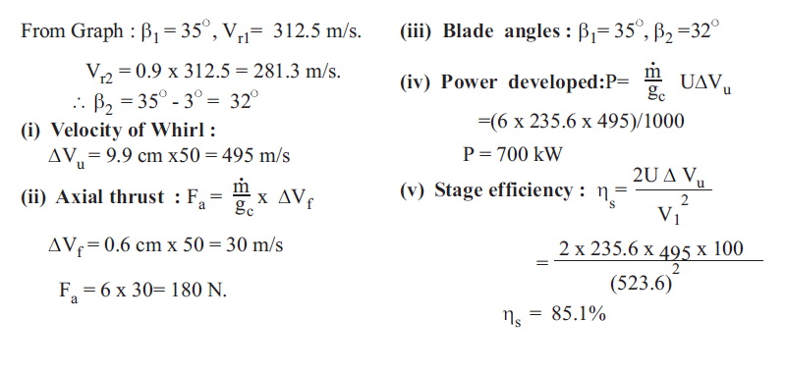
solution

Slide 33
Problems 2
Example 2 :
Steam flows through the nozzle with a velocity of 450 m/s at a direction which is inclined at an angle of 16 to the wheel tangent. Steam comes out of the moving blades with a velocity of 100 m/s in the direction of 110 with the direction of blade motion. The blades are equiangular and the steam flow rate is10 kg/s. Find:
Power developed,
The power loss due to friction
Axial thrust
Blade efficiency and
Bladecoefficient.

Slide 34
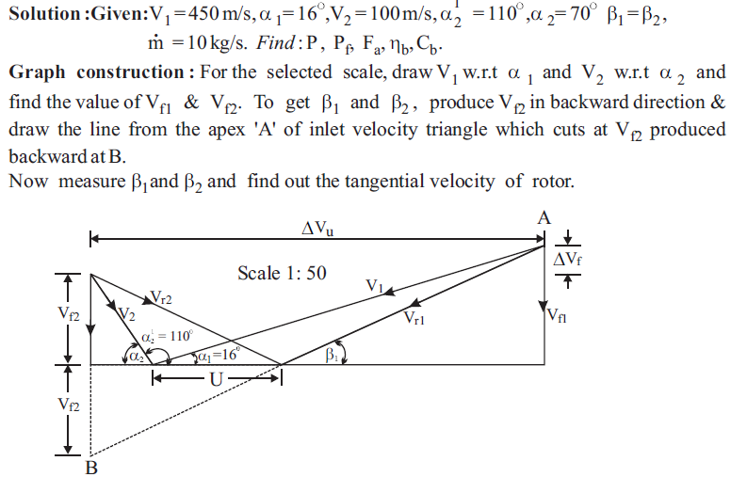
solution

Slide 35
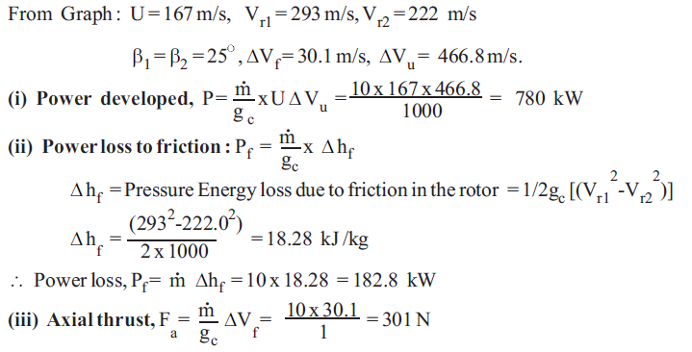
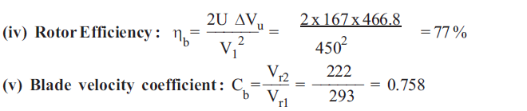
solution

Slide 36
Reaction Turbine
The reaction turbine using now-a-days are of Impulse-Reaction turbines. Pure reaction turbines are not in general use. The expansion of steam and heat drop occur both in fixed and moving blades. All reaction turbines are of axial flow type.

Slide 37
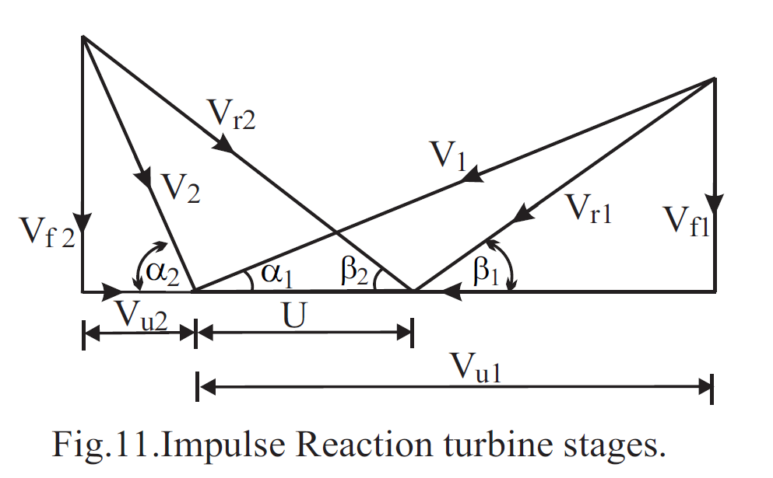
Velocity Triangles for General case
In reaction turbine, steam continuously expands as it flows over the blades. The effect of the continuous expansion during the flow over the moving blades is to increase the relative velocity of steam ie.,Vr2 >Vr1 ,

Slide 38
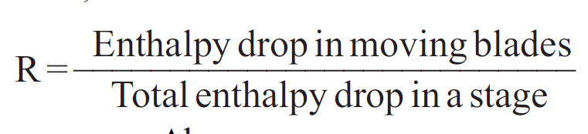
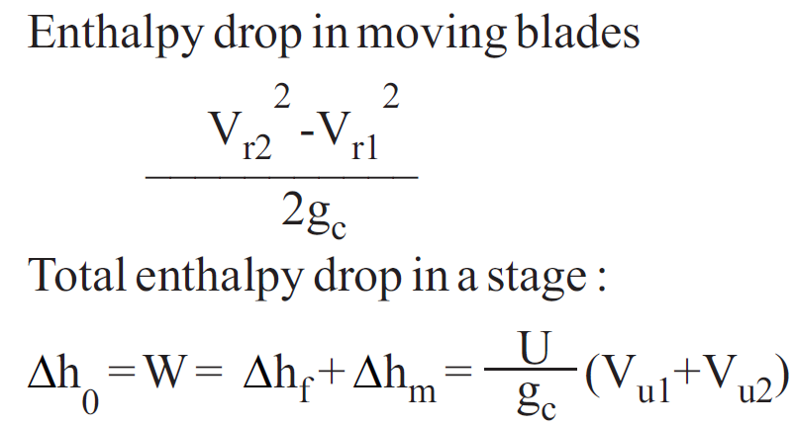
Degree of Reaction (R)
Degree of reaction is defined as the ratio of enthalpy drop in the moving blades to the total enthalpy drop in fixed and moving blades

Slide 39
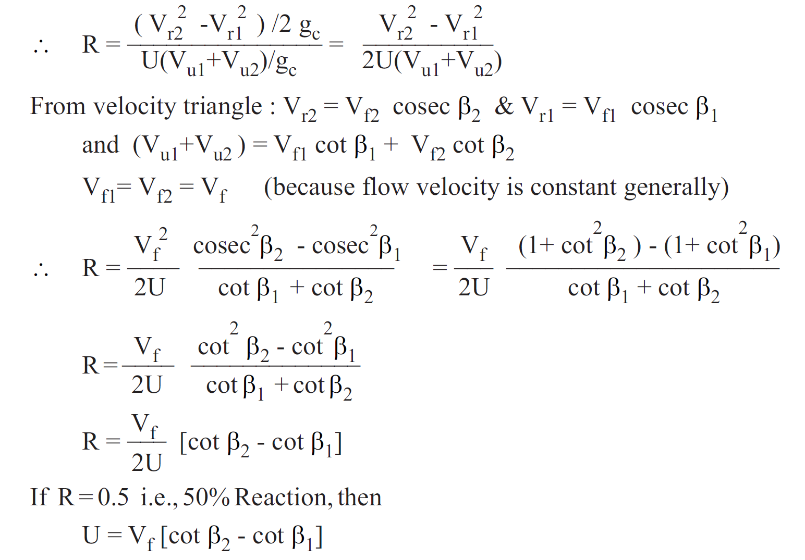

Slide 40
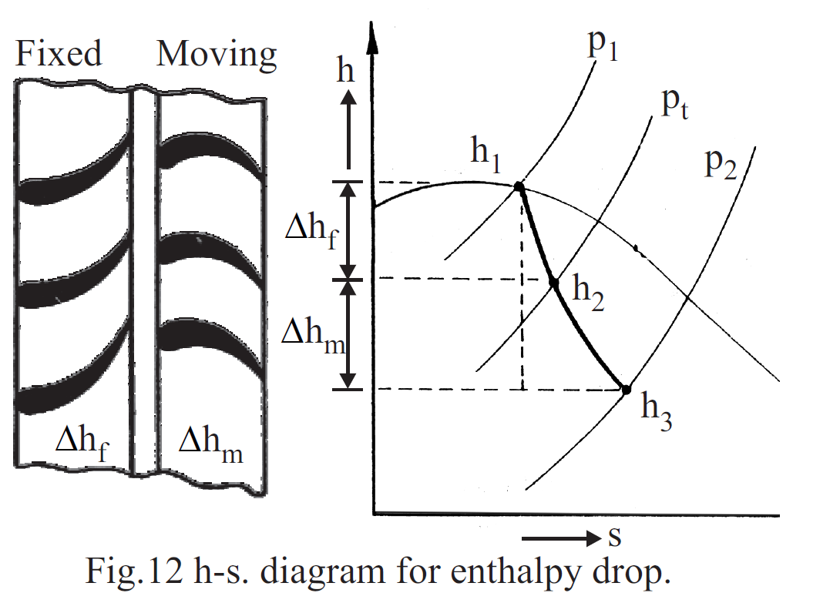


Slide 41
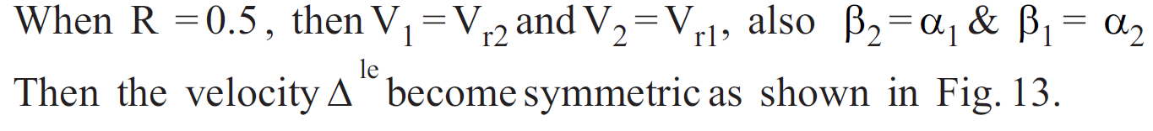
Analysis on 50% Reaction (Parson's) Turbine

Slide 42
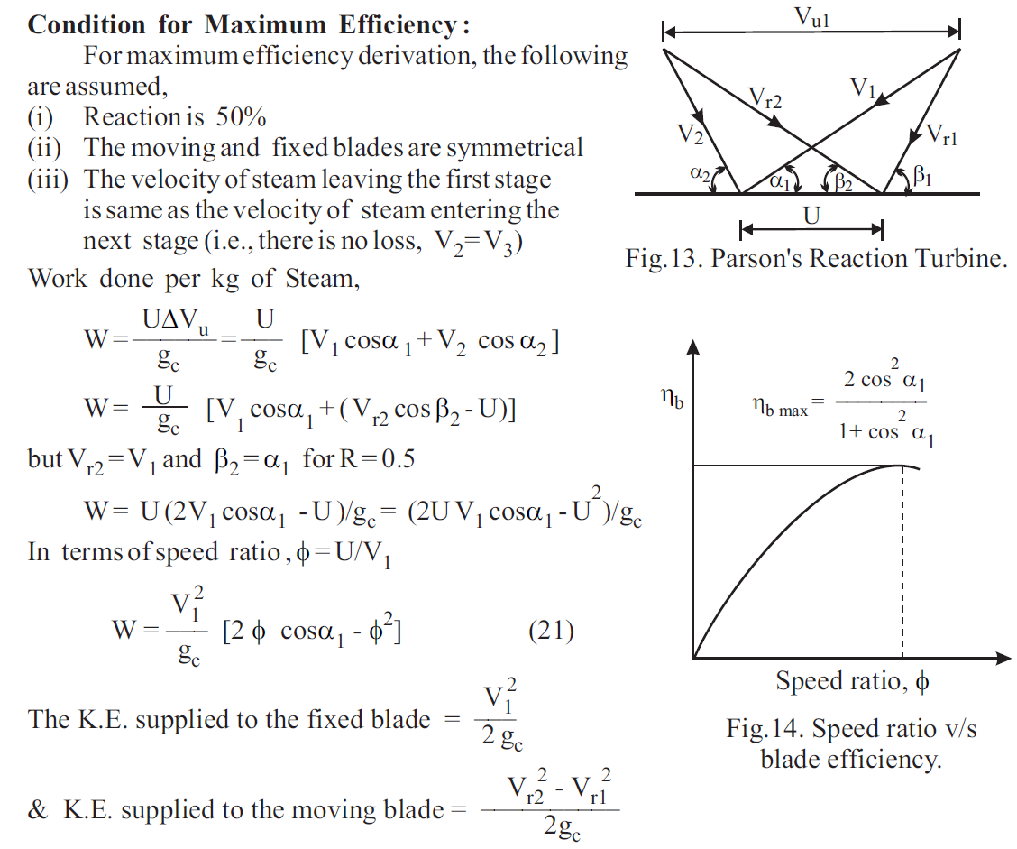

Slide 43
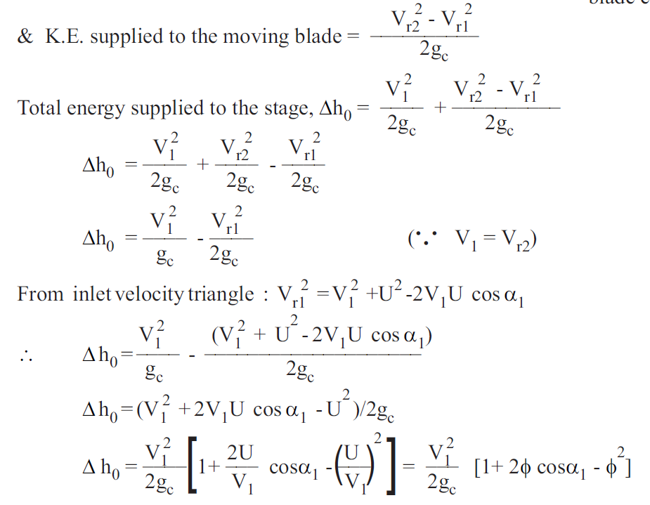

Slide 44
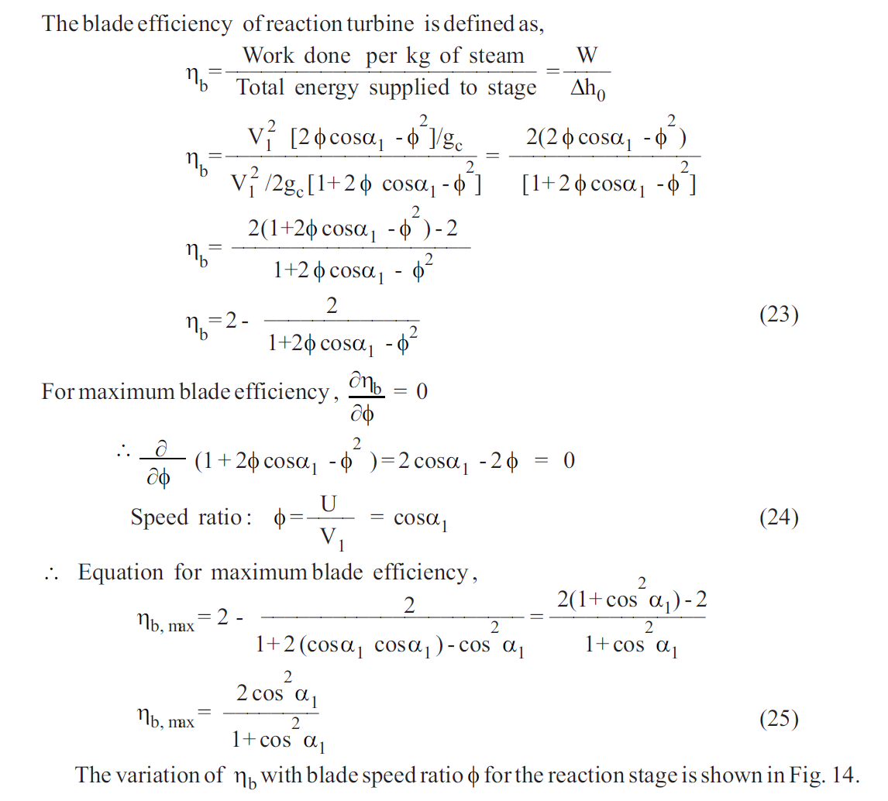

Slide 45
Numerical example
The following data refers to a particular stage of a Parson's reaction turbine. Speed of the turbine = 1500 RPM, Mean diameter of the rotor = 1m, stage efficiency = 0.8, Blade outlet angle = 20 , Speed ratio = 0.7, Determine the available isentropic enthalpy drop in the stage.

Slide 46
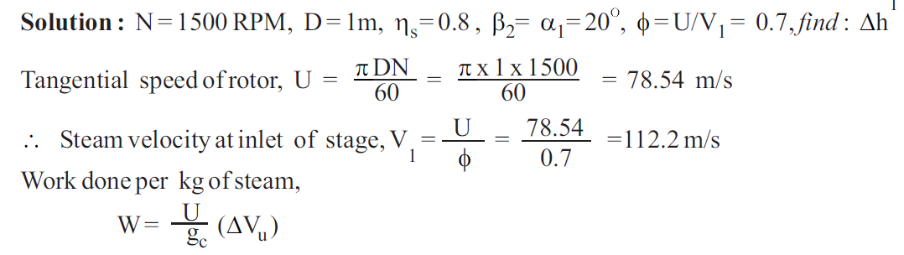
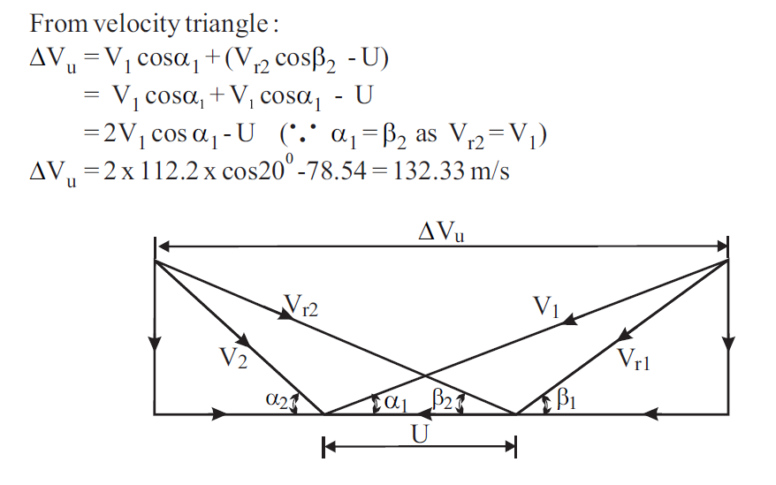

Slide 47
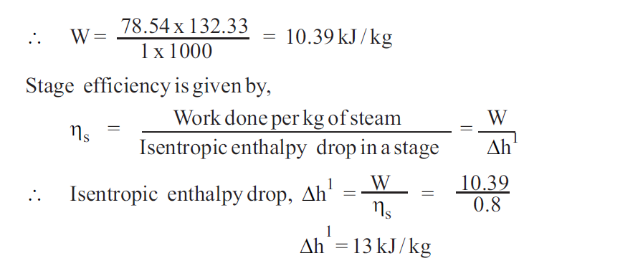

Slide 48
Examples 2
In a reaction turbine, the blade tips are inclined at 35 and 20 in the direction of rotor. The stator blades are the same shape as the moving blades, but reversed in direction. At a certain place in the turbine, the drum is 1m diameter and the blades are 10 cm high. At this place, the steam has a pressure of 1.75 bar and dryness is 0.935. If the speed of the turbine is 250RPM and the steam passes through the blades without shock find the mass of steam flow and power developed in the ring of moving blades.

Slide 49
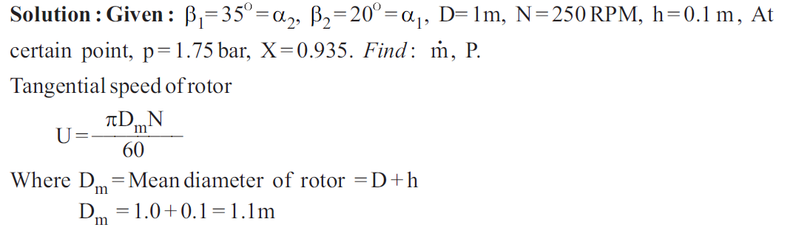
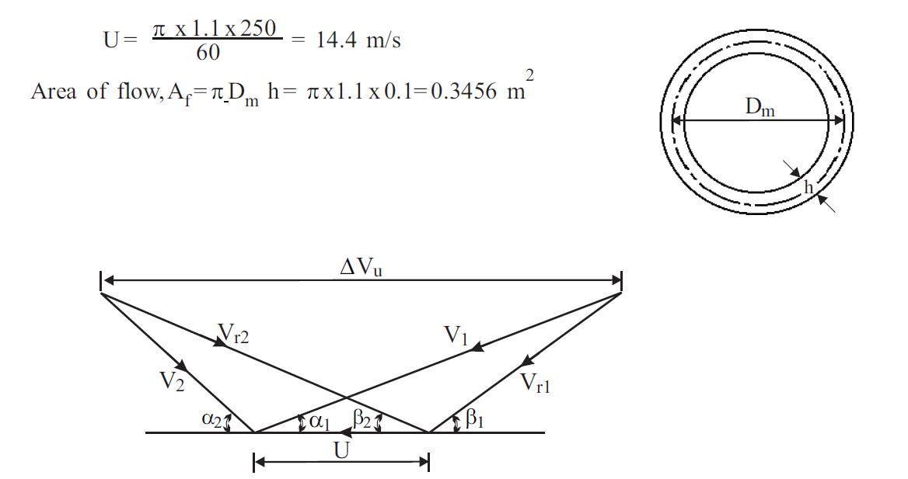

Slide 50
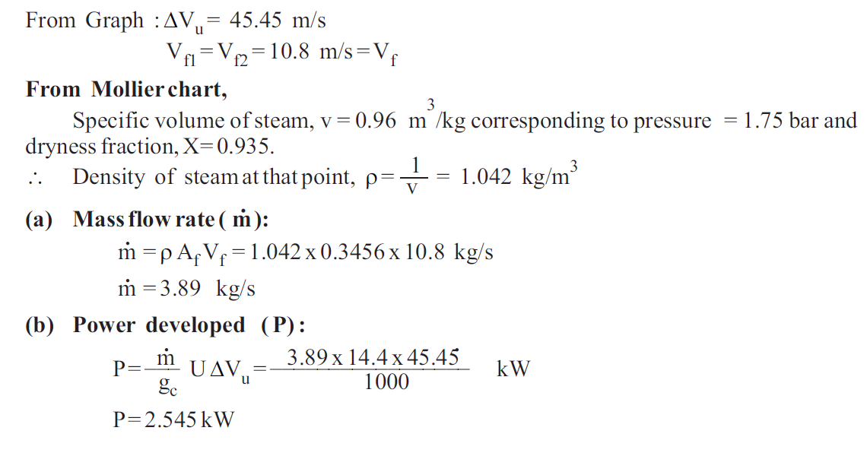

Slide 51
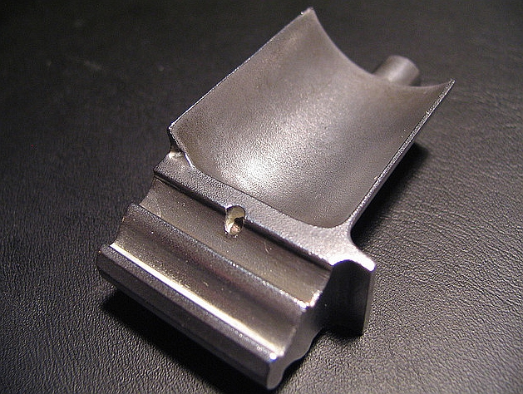
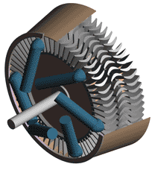
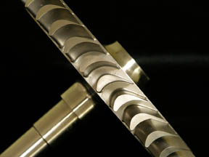
Turbine Components - Blades
Impulse
Reaction

Slide 52
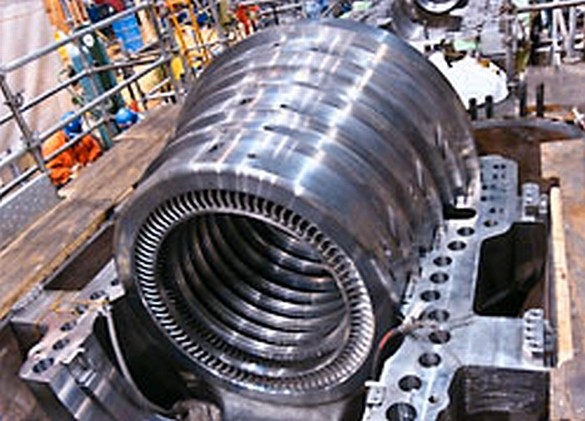
Turbine Diaphragms
Diaphragms contain the fixed blades

Slide 53
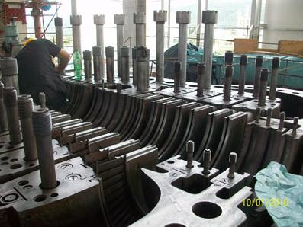
Steam Turbine Casing

Slide 54
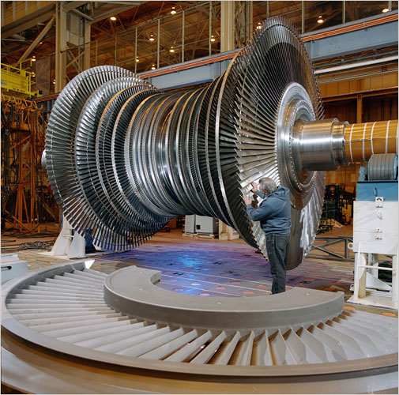
Turbine Rotor

Slide 55
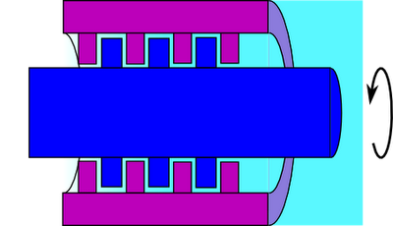
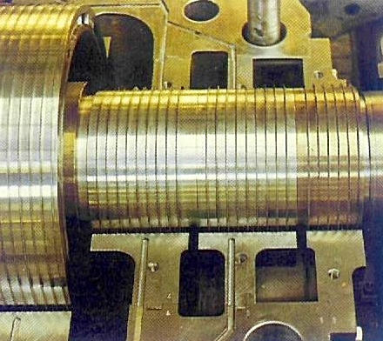
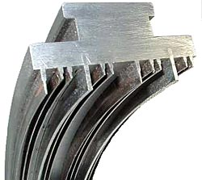
Turbine Shaft and Casing Seals

Slide 56
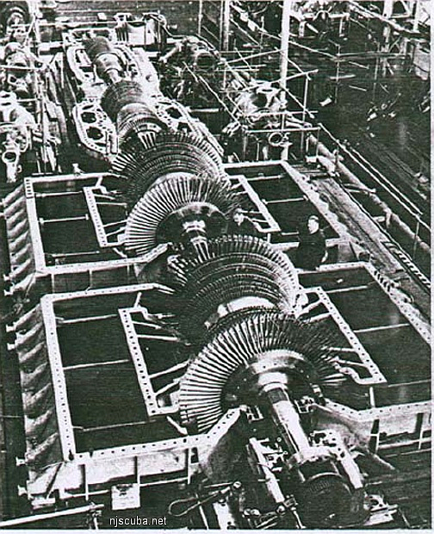
Section 3.1 – Steam Turbine Fundamentals
Turbine Types
Straight HP
Tandem HP
Tandem LP

Slide 57
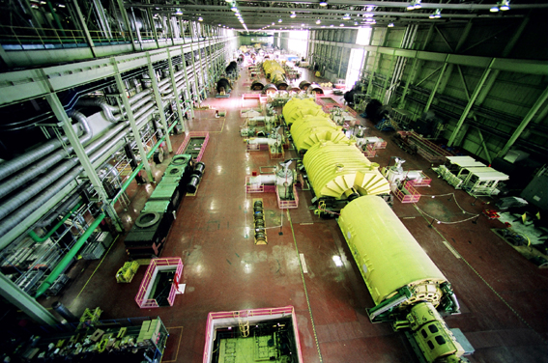
Section 3.1 – Steam Turbine Fundamentals
Turbine – Multiple Sets

Slide 58

Section 3.1 – Steam Turbine Fundamentals
Questions?

Slide 59
Section 3.2 – Steam Turbine Design
Overview
Classification by;
Type – Reaction or Impulse
Steam Temperature and Pressure
Configuration – Compound, Tandem Compound, Cross Compound
Reheat
Output – MW
Structural Elements

Slide 60
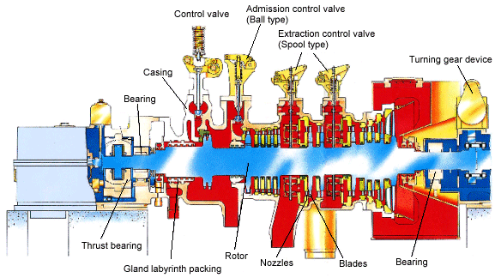
Turbine Design - Basics

Slide 61
Section 3.2 – Steam Turbine Design
Materials
Blades
Stainless Steel – 403 & 422 (+Cr)
17-4 PH steel (+ Ti)
Super Alloys
Rotor
High “Chrome – Moley” Steel – Cr-Mo-V
Low “Ni Chrome Steel – Ni-Cr-Mo-V

Slide 62
Section 3.2 – Steam Turbine Design
Questions?

